Slide 1
Childhood Exposure to Infections and Exceptional Longevity
Leonid A. Gavrilov
Natalia S. Gavrilova
Center on Aging
NORC and The University of Chicago
Chicago, USA

Slide 2
Approach
To study “success stories” in long-term avoidance of fatal diseases (survival to 100 years) and factors correlated with this remarkable survival success
Notes:
2

Slide 3
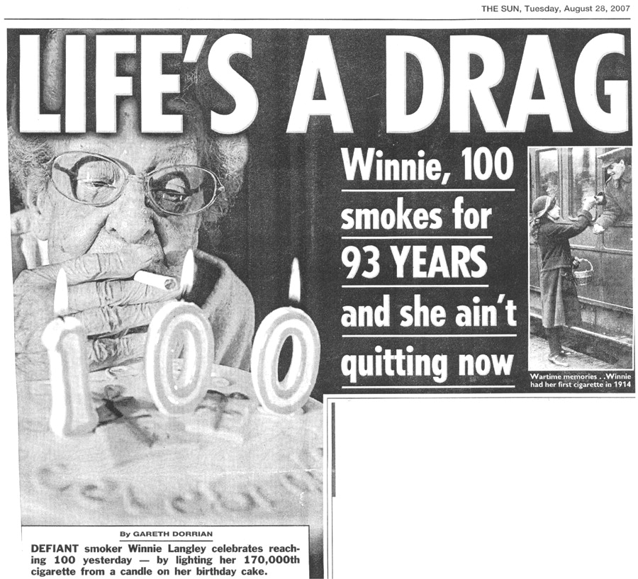

An example of incredible resilience
Winnie ain’t quitting now.
Smith G D Int. J. Epidemiol. 2011;40:537-562
Published by Oxford University Press on behalf of the International Epidemiological Association © The Author 2011; all rights reserved.
Notes:
Winnie ain’t quitting now

Slide 4
Exceptional longevity in a family of Iowa farmers
Father: Mike Ackerman, Farmer, 1865-1939 lived 74 years
Mother: Mary Hassebroek 1870-1961 lived 91 years
Engelke "Edward" M. Ackerman b: 28 APR 1892 in Iowa 101
Fred Ackerman b: 19 JUL 1893 in Iowa 103
Harmina "Minnie" Ackerman b: 18 SEP 1895 in Iowa 100
Lena Ackerman b: 21 APR 1897 in Iowa 105
Peter M. Ackerman b: 26 MAY 1899 in Iowa 86
Martha Ackerman b: 27 APR 1901 in IA 95
Grace Ackerman b: 2 OCT 1904 in IA 104
Anna Ackerman b: 29 JAN 1907 in IA 101
Mitchell Johannes Ackerman b: 25 FEB 1909 in IA 85

Slide 5
Hypothesis
Early exposure to infections decreases chances of survival to advanced ages affecting mortality later in life (Finch, Crimmins, 2004).
Notes:
5

Slide 6
Studies of centenarians require careful design and serious work on age validation
The main problem is to find an appropriate control group

Slide 7
Approach used in this study
Compare centenarians and shorter-lived controls, which are randomly sampled from the same data universe: computerized genealogies
Notes:
7

Slide 8
Study design
Compare centenarians with their peers born in the same year but died at age 65 years
It is assumed that the majority of deaths at age 65 occur due to chronic diseases related to aging rather than injuries or infectious diseases (confirmed by analysis of available death certificates)
Notes:
8

Slide 9
Case-control study of longevity
Cases - 765 centenarians survived to age 100 and born in USA in 1890-91
Controls – 783 their shorter-lived peers born in USA in 1890-91 and died at age 65 years
Method: Multivariate logistic regression
Genealogical records were linked to 1900 and 1930 US censuses providing a rich set of variables
Notes:
9

Slide 10
Age validation is a key moment in human longevity studies
Death dates of centenarians were validated using the U.S. Social Security Death Index
Birth dates were validated through linkage of centenarian records to early U.S. censuses (when centenarians were children)

Slide 11
Genealogies and 1900 and 1930 censuses provide three types of variables
Characteristics of early-life conditions
Characteristics of midlife conditions
Family characteristics

Slide 12
Early-life characteristics
Type of parental household (farm or non-farm, own or rented),
Parental literacy,
Parental immigration status
Paternal (or head of household) occupation
Number of children born/survived by mother
Size of parental household in 1900
Region of birth
Notes:
12

Slide 13
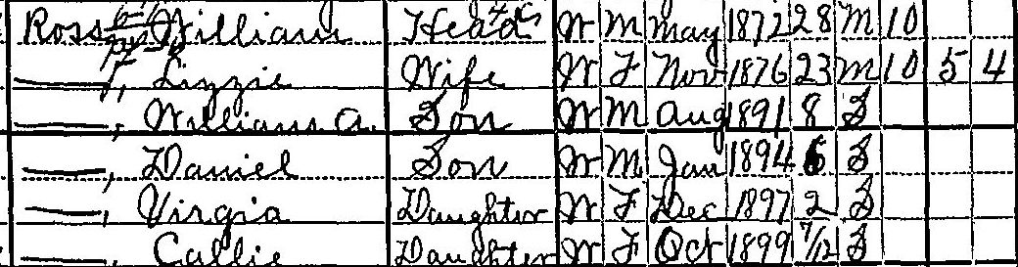
A typical image of ‘centenarian’ family in 1900 census
Notes:
13

Slide 14
Infectious burden
Infectious burden was estimated as a within-family child mortality.
Information on children ever born and children survived by mothers of centenarians and controls available in 1900 and 1910 U.S. censuses allowed us to estimate child mortality index for each family, where biological mother is present.
Notes:
14

Slide 15
Child Mortality Index
Is defined as the ratio of actual child deaths to expected child deaths for individual women or groups of women (Preston and Haines 1991; Preston, Heuveline and Guillot 2001).
Serves as a proxy of infectious disease burden in the particular family characterizing the living environment, as suggested by other researchers (Bengtsson and Lindstrom 2000, 2003; Bengtsson and Mineau 2009; Finch and Crimmins 2004; Preston and Haines 1991).
Notes:
15

Slide 16
Child Mortality Index, Estimation
Method suggested by Preston and Palloni (1977)
First, the expected number of dead children for the ith woman in marital duration group j, ED_{ij}, is given by
ED_{ij} = B_{i} EPD_{j} = B_{i} x q(a)/K_{j}
where EPD_{j} is the expected proportion of children who died among women in marital-duration group j under the standard mortality schedule, q(a) is the probability of dying from birth to age “a” and K_{j} is a multiplier for this marital duration category (taken from the United Nations Manual X
Notes:
16

Slide 17
Child Mortality Index, Estimation (2)
K values are calculated according to the United Nations Manual X (1983) using formula:
K(i) = a(i)+b(i)(P(1)/P(2))+c(i) (P(1)/P(2))
P(i) is calculated using formula:
P(i) = CEB(i)/MFP(i)
where CEB(i) is the number of children ever born reported by women belonging to duration group i and MFP(i) is the total number of ever married women in duration group i. Coefficients a(i), b(i) and c(i) are taken from Table 56 of the UN Manual X.
Notes:
17

Slide 18
Child Mortality Index, Estimation (2)
The values of probabilities of dying, q(a), are taken from the model life table (model West life table, level 13.0 with males and females combined). The West level 13.0 corresponds to under-five mortality, q(5), of 0.191, the infant mortality rate of 0.129, and life expectancy at birth equal to 48.5 years. It was shown that this level provides a good fit to historical data on the U.S. mortality (Preston and Haines 1991).
Using this procedure, we assigned a child mortality index (before age 5) to each mother of cases and controls, which allowed us to estimate within-family effects of child mortality.
Notes:
18

Slide 19
Midlife Characteristics from 1930 census
Type of person’s household
Availability of radio in household
Person’s age at first marriage
Person’s occupation (husband’s occupation in the case of women)
Industry of occupation
Number of children in household
Veteran status, Marital status
Notes:
19

Slide 20


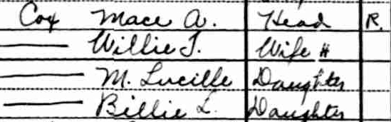
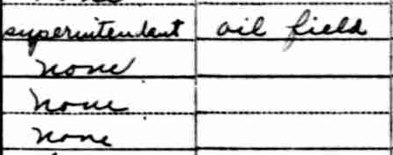
Example of images from 1930 census (controls)
Notes:
20

Slide 21
Family Characteristics from genealogy
Information on paternal and maternal lifespan
Paternal and maternal age at person’s birth,
Number of spouses and siblings
Birth order
Season of birth
Notes:
21

Slide 22
Results
Centenarians and controls had approximately equal sibship sizes on average (7.6 and 7.8 respectively), which are higher compared to the general population in 1900 census (5.6) suggesting larger sizes of families presented in computerized genealogies.
Mean Child Mortality Index (CMI) in 1900 for families of centenarians is equal to 0.532 (95% CI = 0.480-0.585).
Mean CMI in 1900 for control families is equal to 0.565 (0.508-0.622).
Notes:
22

Slide 23
Parental longevity, early-life and midlife conditions and survival to age 100. Men
Multivariate logistic regression, N=634
Variable | Odds ratio | 95% CI | P-value
Father lived 80+ | 1.73 | 1.25-2.41 | 0.001
Mother lived 80+ | 1.70 | 1.22-2.37 | 0.002
Farmer in 1930 | 1.84 | 1.30-2.61 | 0.001
Born in North-East | 2.00 | 1.16-3.43 | 0.012
Born in the second half of year | 1.25 | 0.91-1.74 | 0.174
Radio in household, 1930 | 0.85 | 0.60-1.20 | 0.352
Child mortality Index | 0.53 | 0.81-1.26 | 0.934
Notes:
23

Slide 24
Parental longevity, early-life and midlife conditions and survival to age 100, Women
Multivariate logistic regression, N=815
Variable | Odds ratio | 95% CI | P-value
Father lived 80+ | 2.17 | 1.57-3.00 | <0.001
Mother lived 80+ | 2.13 | 1.56-2.91 | <0.001
Husband farmer in 1930 | 1.25 | 0.90-1.73 | 0.177
Radio in household, 1930 | 1.71 | 1.23-2.37 | 0.001
Born in the second half of year | 1.27 | 0.93-1.73 | 0.173
Born in the North-East region | 0.99 | 0.60-1.64 | 0.979
Child Mortality Index | 0.89 | 0.72-1.11 | 0.306
Notes:
24

Slide 25
Other variables found to be non-significant in multivariate analyses
Parental literacy and immigration status, farm childhood, size of household in 1900, sibship size, father-farmer in 1900
Marital status, veteran status, childlessness, age at first marriage
Paternal and maternal age at birth, loss of parent before 1910

Slide 26
Conclusions
Child Mortality Index (CMI) in families of centenarians is not significantly different from CMI in control families suggesting that infectious load during childhood does not influence mortality after age 65 years.
The results of this study suggest that parental longevity and mid-life characteristics rather than childhood infections play an important role in exceptional longevity.
Notes:
26

Slide 27
Acknowledgment
This study was made possible thanks to:
generous support from the National Institute on Aging grant #R01AG028620
stimulating working environment at the Center on Aging, NORC/University of Chicago

Slide 28
For More Information and Updates Please Visit Our Scientific and Educational Website on Human Longevity:
http://longevity-science.org
And Please Post Your Comments at our Scientific Discussion Blog:
http://longevity-science.blogspot.com/
Notes:
28

