Slide 1




Vaginal cytological characteristics as a biomeasure of estrogenization in a community-based population of older women
Natalia Gavrilova, PhD^{1,2} Annie Dude, MD, PhD¹; Joscelyn N. Hoffmann, AB³; Martha K. McClintock, Ph.D.^{2,3,4} L. Philip Schumm, MA⁵; Stacy Tessler Lindau, MD, MAPP^{1,2, 4, 6}
1 Pritzker School of Medicine, Department of Ob/Gyn, 2 Chicago Core on Biomeasures in Population-Based Research at the NORC-University of Chicago Center on Demography and Economics of Aging; 3 Institute for Mind and Biology, Departments of Psychology and Comparative Human Development 4; Comprehensive Cancer Center, 5 Department of Health Studies. and Department of Medicine (Gerontology), The University of Chicago
Notes:
I added the project logo, as we want to encourage them to use the data.
I also added the IMB logo—we are a multidisciplinary team, which is cool. I took out the center logo, as it is covered by CCBAR

Slide 2
Disclosures
Funding for this analysis:
  NIH 5R01AG021487 (Waite, PI)
  1K23AG032870 (Lindau, PI)
  5P30 AG 012857 (Waite, PI)
The authors report no conflicts of interest
Notes:
I added the Institute along the bottom as well, Didn’t know how to add to the master

Slide 3
Background
Vaginal mucosa is a target tissue for a broad spectrum of estrogens.
Vaginal atrophy
  Indicates an estrogen deficit.
  May interfere with sexual and urinary function.
  Increases with age after menopause.
Notes:
While there has been fluctuations in rate of estrogen therapy uptake over the past two decades, currently about 1 in 10 postmenopausal women uses some form of estrogen therapy.
2. Vaginal atrophy can lead to vaginal dryness, pain during sex, and urinary problems, including UTIs, urinary incontinence, and urinary urgency.

Slide 4
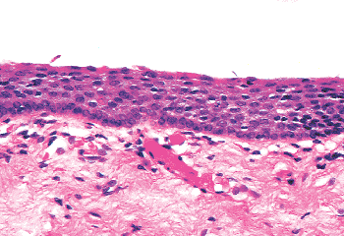
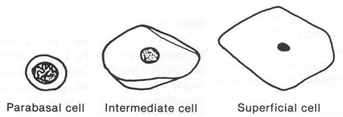
Vaginal Epithelium
Layers
superficial
intermediate
parabasal
basal
Estrogenized
Atrophic
Three Types (Or Stages) of Vaginal Epithelial Cells
All scored to quantify estrogenization in the Vaginal Maturation Index
The Vaginal Maturation Index quantifies the relative proportion of the vaginal parabasal (P), intermediate (I), and superficial (S) cells presented as % P / % I / % S.
Sources: Mills, Histology for Pathologists. 3rd Edition; LWW, 2006. Wheater, Functional Histology. 2nd Edition; Bibbo, 1997
Notes:
The picture on the left depicts a highly estrogenized vaginal epithelium. There are four distinct cell layers in the vaginal epithelium: superficial, intermediate, parabasal and basal. Three cell types are used for hormonal interpretation: superficial, intermediate, and parabasal. The more estrogen that the vaginal epithelium receives, the thicker it becomes resulting in increased presence of intermediate and superficial cells .
2. In contrast, the photo on the right shows atrophic vaginal epithelium, with only parabasal and basal layers .

Slide 5
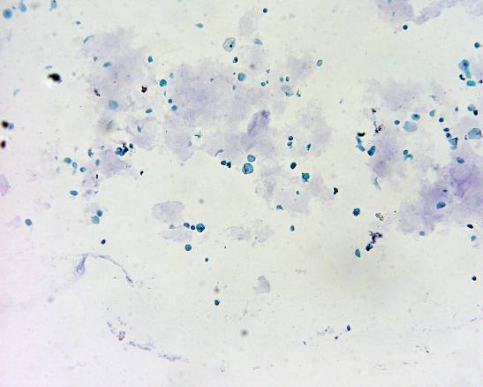
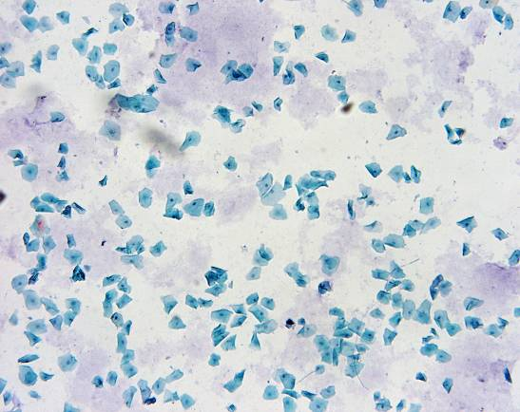
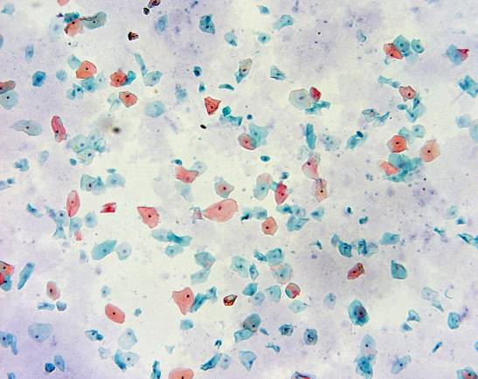
Quantifying Types of Desquamated Vaginal Epithelial Cells
LESS ESTROGENIZED
INTERMEDIATE
MORE ESTROGENIZED
Multichrome Papanicolaou stained cytology specimens
obtained using vaginal self-swabs in NSHAP Wave 1.
McClintock lab:
• scored number and proportion of three epithelial cell types
• created a Maturation Index (MI).
Notes:
Cells on the surface of the vaginal epithelium are exfoliated at the peak of maturation. The array of cells present can be observed with the Papanicolaou stain and light microscopy. The maturation value is calculated using a weighted average of the relative percentage of each of the three cell types: parabasal, intermediate, and superficial.
As you can see in these slides, not all of the cells on the ‘more estrogenized’ slide are superficial, but there is a higher percentage of superficial cells present here than in the other two slides.
3. Gynecologists use the maturation value to diagnose patients with vaginal atrophy. The closer the maturation value is to zero, the more atrophic the epithelial tissue.

Slide 6
Methods

Slide 7
National Social Life, Health and Aging Project (NSHAP) Wave 1
Nationally representative sample of people 57 to 85 years of age (Wave 1, 2005 – 06).
Demographic, health, sexual, physical, and biological measures collected in the home.
Vaginal swabs were self-collected and used for the following measures:
  Maturation Value (MV)
  Vaginal Candidiasis (yeast)
  Bacterial Vaginosis (BV)
  High Risk Human Papilloma Virus (HPV)
  The Institutional Review Boards of the University of Chicago and the National Opinion Research Center approved the protocol; all participants provided written documentation of informed consent.
Notes:
I put the informed consent here, as it is part of subject recruitment and consent for these specific procedures

Slide 8
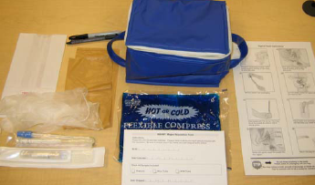


Vaginal Swab
Sample Collection
Illustrated by Rachel Seelen
Notes:
These illustrated instructions on the right were created by Dr. Lindau in conjunction with a medical illustrator as NSHAP Wave 1 represented the first attempt to obtain self-collected vaginal swab samples from a community – based population of older women in a survey conducted in the home.

Slide 9


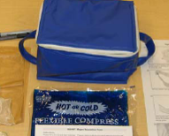


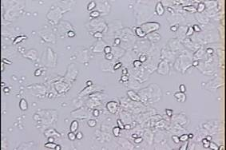

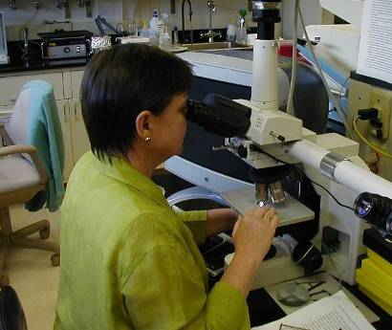

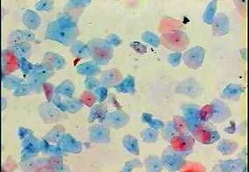
July 1, 2005
McClintock Lab
Institute for Mind and Biology
Chicago, IL
July 20, 2005
Cells from swab to slide,
MI
Jordan Lab, Magee Women’s Hospital Pittsburgh, PA
July 6, 2005
BV, Yeast, HPV
Cytopathology Lab
University of Chicago Hospitals
Chicago, IL
January 2006
Papanicolaou Stain
Notes:
Over many years, Martha McClintock’s lab has perfected the method of vaginal epithelial cell lavage in rats. These rat-based methods were translated to in order to get the human vaginal epithelial cells from the swab using a Hanks’ Balanced Salt solution and onto a slide for immediate fixing and later pap-staining.
Slides were processed and evaluated with the assistance of Dr. Martha McClintock’s laboratory, the members of which have extensive experience evaluating the vaginal cytology of rats for purposes of determining estrous cycles.

Slide 10
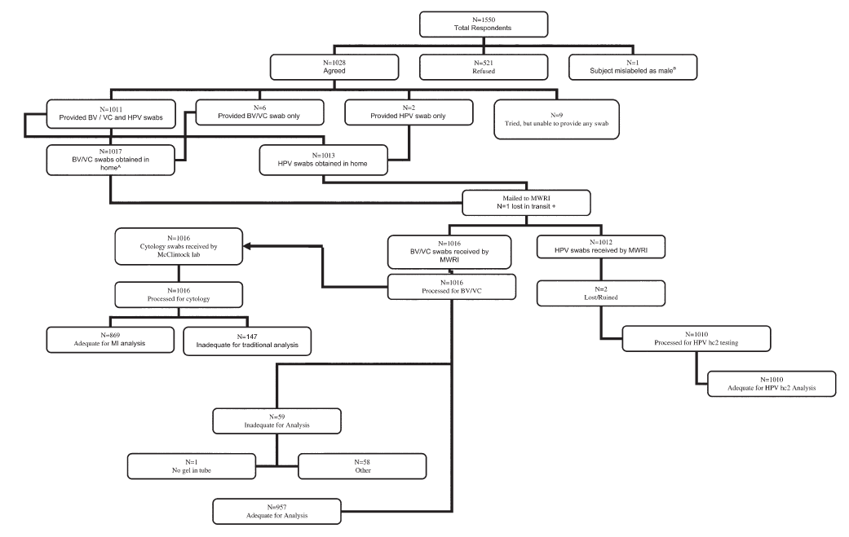
Flow chart of vaginal swabs collection
Vaginal swab collection
Notes:
1. Of the 3,005 people participating in the study 1,550 were women. Of these, 1,028 gave a vaginal swab for a participation rate of 67%. Of these swabs, 869 were adequate for MV assessment.
2. Estrogen use was assessed using a systematic medication log.

Slide 11
Successful Vaginal Swab Collection
66% of women agreed to provide a self-administered vaginal swab specimen (N = 1,028 of 1,550)
85% were adequate for MI scores (N = 869 of 1,028)
Non-responders to the vaginal swab protocol were :
  older
  <HS graduate
  less likely to report a recent pelvic examination, menopausal prescription hormone use
  Lindau et al., 2008

Slide 12
The Maturation Value
is a clinical measure of vaginal estrogenization
derived from the Maturation Index
Maturation Value =
1.0 x % superficial cells +
0.5 x % intermediate cells +
0.0 x % parabasal cells
Potential range: 0 – 100
Notes:
Gynecologists use the maturation value to diagnose patients with vaginal atrophy.
It is based only on the % of superficial and intermediate cells.The closer the maturation value is to zero, the more atrophic the epithelial tissue.

Slide 13
Maturation Value of the Vaginal Epithelium
suggested by Meisels in Acta Cytologica, 1965, who called it an “estrogenic value”
a bioassay of functionally active estrogens counteracted by progesterone
provides an integrated measure of hormonal bioactivity over many days
based only on intermediate and superficial epithelial cells
Notes:
In contrast to a single serum or salivary hormone assay, MV of the vaginal epithelium

Slide 14
Hypotheses
Vaginal epithelial estrogenization among post-menopausal women will be:
Inversely associated with age and years since menopause Rationale: Results from historical clinical study (Meisels, 1966)
Positively associated with obesity Rationale: Abdominal fat tissue can produce estrone
Higher in African American women compared to other racial and ethnic groups. Rationale: Existing publications (McTernan, Wu, 2008; Setiawan, et al., 2006) and our own results from the NSHAP study suggest that African-American women have higher levels of free estradiol
Positively associated with sexual function

Slide 15
Clinical Benchmark Study of Canadian Gynecology Patients
Reference: Meisels A. Menopause - A cytohormonal study. Acta Cytol. 1966;10(1):49-55
Notes:
This figure comes from the benchmark study on the mean maturation value at different ages. These data come from a clinical sample of women seeking care for gynecologic complaints. Study subjects are clustered in the lower end of the age spectrum. As you can see, the mean maturation value declines across age groups.
2. These data were collected from 1961 – 1966. Since the 1960s, widespread shifts in the use of estrogen have occurred . These changes include not only postmenopausal estrogen therapy , but also hormonal contraception and [possibly] increased exposure to environmental estrogen. Population based norms for vaginal cytology have not been established for older women.
Meisels, A. The menopause: A cytohormonal study. Acta Cytol 1966 Jan – Feb; 10(1): 49 – 55.

Slide 16
Results

Slide 17
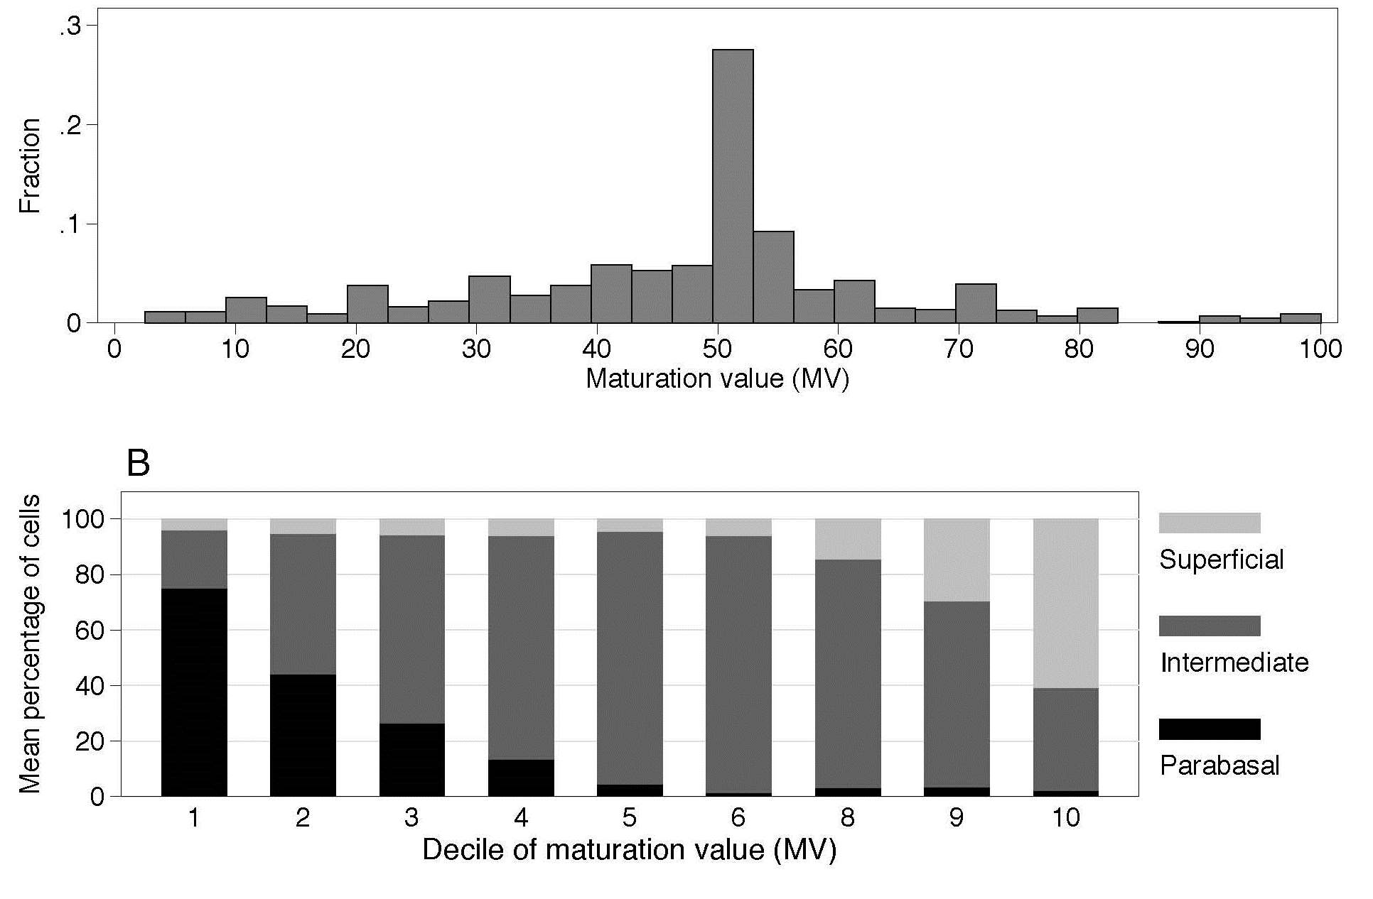
Distribution of Maturation Value in NSHAP Wave 1
Notes:
Point out that this shows the relationship of the maturation INDEX (the % of all three epithelial cell types represented by the stacked bar graph) and the maturation VALUE, which is based only on the % of intermediate and superficial cells—the score that is plotted in Figure A, and in deciles in B

Slide 18
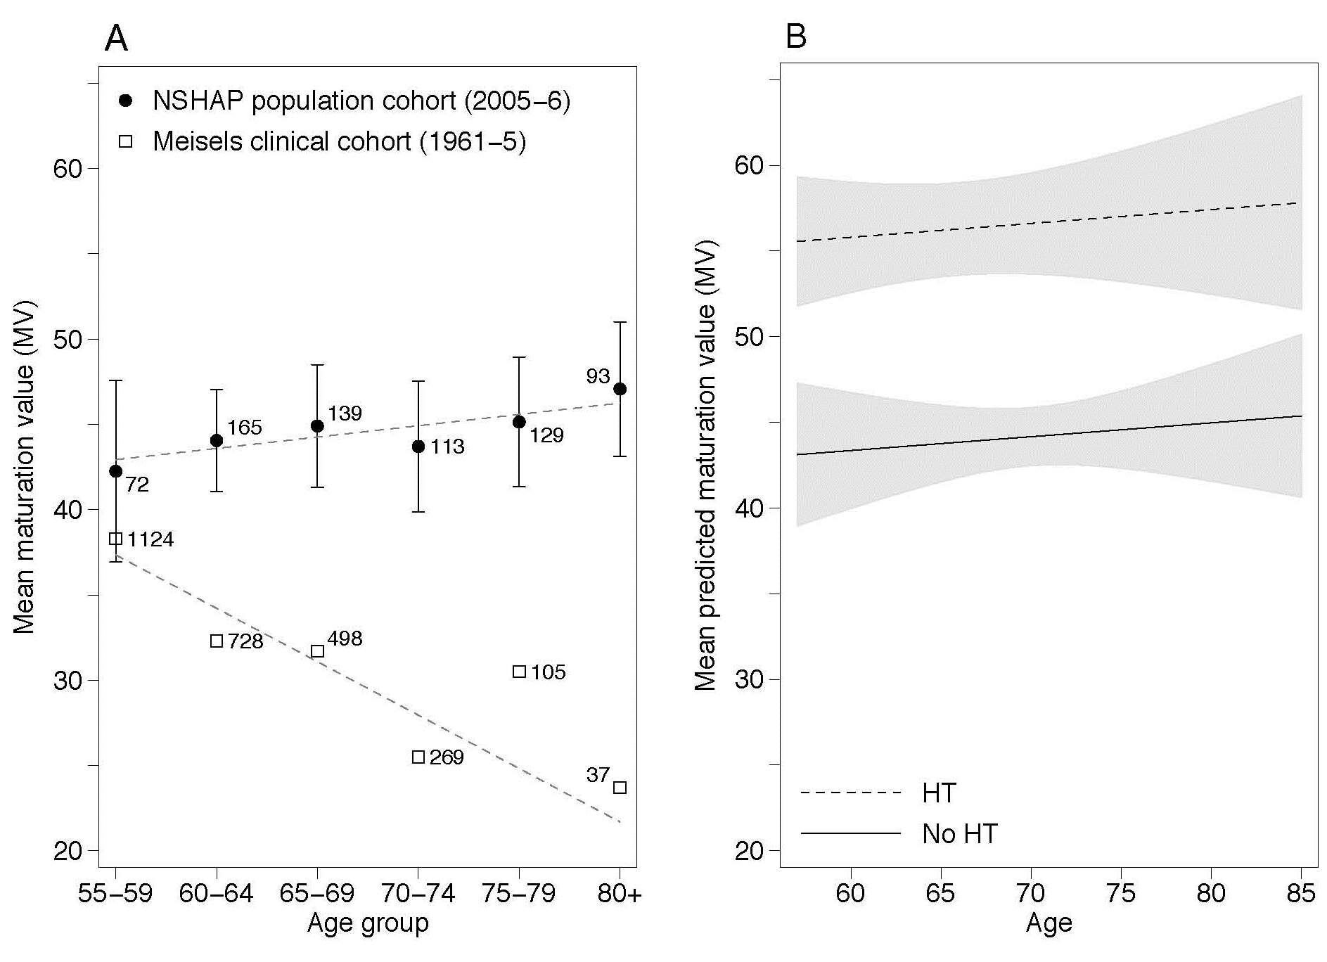
Maturation Value: (A) Age and (B) Hormone Therapy Use Use

Slide 19
Testing hypotheses using the maturation value
#1: Linear regression model to determine correlates (X) of the maturation value (Y).
Y = β₀ + β₁X₁ +...+ β_{k}X_{k}
Maturation value = β₀ + β₁hormone therapy +…+ β_{k}X_{k}
Other covariates tested
Demographic characteristics:
Age, Race, Ethnicity, Education
Health characteristics:
Oophorectomy, Obesity, Hormone therapy past 12 mo, Sexual activity

Slide 20
Multiple linear regression model of the maturation value (MV), NSHAP Wave 1
Covariate | Parameter estimate | 95% CI | P-value
Age | 0.08 | -0.21, 0.38 | 0.59
Years since last menstrual period | 0.10 | -0.05, 0.24 | 0.19
African-American race (vs white, ref.) | 8.58 | 5.07, 12.08 | <0.001
Some college/associates education (vs HS graduate, ref.) | -2.64 | -5.25, -0.02 | 0.048
HT use in last 12 months | 12.44 | 9.19, 15.70 | <0.001
Waist circumference (inches) | 0.58 | 0.34, 0.82 | <0.001
Effects of other covariates in the model (Bilateral oophorectomy, Sexual activity past 12 months and Hispanic ethnicity) turned out to be non-significant.
Notes:
As you can see, in multivariate models, age and years elapsed since menopause were not significant correlates of the maturation value.
Women who are obese tend to have higher levels of circulating estrogen.
3. Not surprisingly, women currently taking estrogen also have higher maturation values, 15.2 points higher on average than women not taking estrogen currently

Slide 21
#2: Logistic regression using the standardized maturation value as an independent variable (X) to predict symptoms/conditions (Y).
Prob.(symptom) =
Symptoms/Conditions examined:
Sexual Activity Bacterial vaginosis,
Pain during sex Yeast infection
Vaginal dryness during sex High-risk HPV
Urinary incontinence Other urinary problems,
Notes:
But, is our measure of vaginal estrogenization, the maturation value, useful for predicting symptoms? We use logistic regression to model the probability of symptomatic outcomes using the maturation value as an independent variable.
In these models, we also control for age and current hormone therapy.

Slide 22
Logistic regression models of clinical and behavioral outcomes on standardized maturation value (MV), NSHAP Wave 1
Outcome | Odds ratio | 95% CI | P-value
Sexual activity (within the past 12 months) | 0.88 | 0.73, 1.05 | 0.15
Pain during sex (for sexually active women) | 0.80 | 0.55, 1.17 | 0.24
Problems lubricating (for sexually active women) | 0.61 | 0.46, 0.82 | 0.001
Current bacterial vaginosis | 1.54 | 1.26, 1.88 | <0.001
Current yeast infection | 1.56 | 1.15, 2.13 | 0.005
High-risk HPV | 1.08 | 0.78, 1.51 | 0.63
Maturation value standardized by subtracting the sample mean and dividing by the sample standard deviation.
Notes:
In these models, controlling for age and hormone use past 12 mo, vaginal estrogenization (as measured with the maturation value) is predictive of health outcomes. Women with a higher degree of vaginal estrogenization are more likely to have a current yeast infection, and are more likely to experience other urinary problems such as difficulty postponing urination.
2. Vaginal estrogenization was not predictive of whether a woman was sexually active in the past 12 months. Rather, whether she had a spouse or other partner was determinant of sexual activity, a finding in keeping with previous literature on this subject.
Among currently sexually active women, however, those with a lower degree of vaginal estrogenization (MV) were more likely to experience vaginal dryness during sex.

Slide 23
Conclusions

Slide 24
Hypotheses tested
Vaginal epithelial estrogenization among post-menopausal women will be:
Inversely associated with age and years since menopause? No
Positively associated with abdominal obesity: Yes
Higher in African American women compared to other racial and ethnic groups: Yes
Positively associated with sexual function: Yes, mostly

Slide 25
Summary:
Maturation value is an integrative biomeasure of estrogenization of women, useful for analyses of health and sexuality
In contrast to 1960s benchmark clinical data, current population estimates of vaginal estrogenization are higher and do not exhibit a decline with age.
Differences may be explained in part by studying different populations:
  Women who come to a clinic
  Representative sample of community-dwelling older women in the US.
Notes:
Geospatial and temporal trends relating to exogenous estrogen exposure over the life course could explain this and racial differences.
Hormones in processed meat and other foods?
Pesticide use?
Comment for bullet #2: make point that menopausal women presenting for gyn care for gyn problems likely had lower MV than general pop and symptoms related to atrophy.

Slide 26
Study limitations
Selection bias: women who provided a vaginal specimen were, on average:
  younger
  more educated
  more likely to have urinary problems
  more likely to use HT

Slide 27
Acknowledgements
NIH 5R01AG021487 (Waite, PI)
1K23AG032870-01A1 (Lindau, PI)
5P30 AG 012857 (Waite, PI)
National Institute on Aging
Office of Women's Health Research
Office of AIDS Research
Office of Behavioral and Social Sciences Research
Equipment, supplies, services donated or provided at reduced cost for data collection by:
  OraSure, Sunbeam, A&D Medical/LifeSource, Wilmer Eye Institute at the John Hopkins Bloomberg School of Public Health, Schleicher & Schuell Bioscience, BioMerieux, Roche Diagnostics, Digene, and Richard Williams

Slide 28
Additional information can be found at the CCBAR website
http://biomarkers.uchicago.edu/

Slide 29
Chicago Core on Biomarkers in Population-Based Aging Research
CCBAR website
http://biomarkers.uchicago.edu/

